Slide 1
Clinic Data Analysis
Patients complaining about the long wait periods

Slide 2
Purpose of analysis
Clinic/Hospital Data
Clinic has gotten several complaints regarding the long wait times
Our task is to analysis, hypothesis and then create a data driven story on the overall wait time.
Weapons of choice
Excel
Power Point

Slide 3
Management has the following questions on the wait time:
is there a short staffing issue?
are the complaints legitimate?
are we too busy?
is it a certain type of patient?
Insights to establish
Hospital goals: reduce wait times
Metrics of success/failure: wait times
Trends to examine: time of day/week that causes increase in wait times
How to solve trend: is it a staffing issue?

Slide 4

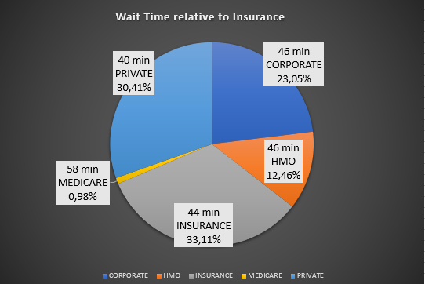
Which patients are waiting the longest
As show via the chart, patients have been categories based on their insurance to breakdown the data to understand which patients are having to wait the longest processing time due to the insurance. However, based on the average time being 44 minutes long, insurance does not greatly contribute to the long wait times. Even though it seems Medicare patients are taking the longest to process, we do not have sufficient data to conclude that, the wait times are caused how long it takes to process patients based on their insurance.

Slide 5
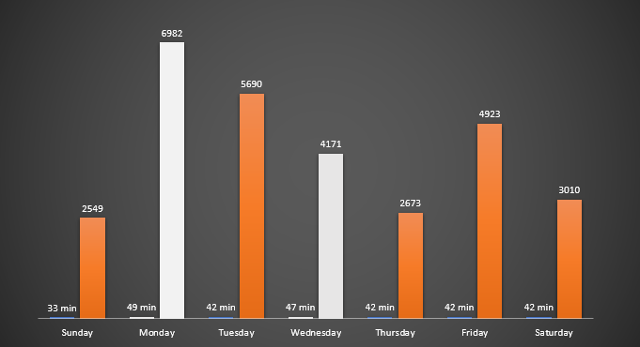
Which days are most affected
44 min
Average Wait Time
As shown in the chart. Mondays and Wednesdays have the highest above average wait times of 49 and 47 minutes respectively.
As such the clinic might consider increasing its staffing on those days to counter the longer waiting time.

Slide 6
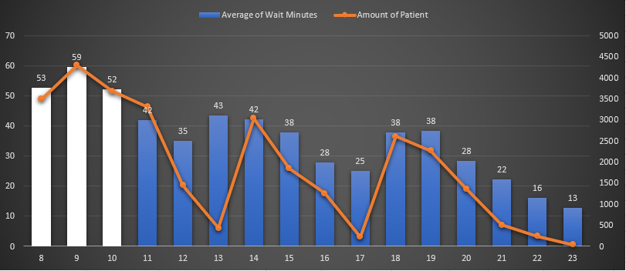
Busiest times of the day
This chart will assist the hospital to be able to know exactly when the busiest time of the day occurs and as such can respond appropriately in assigning more staff during these specific times.
The busiest times range from 8 AM to 10 AM, which is when wait time is above average of 44 minutes and the most amount of custom appear.

Slide 7
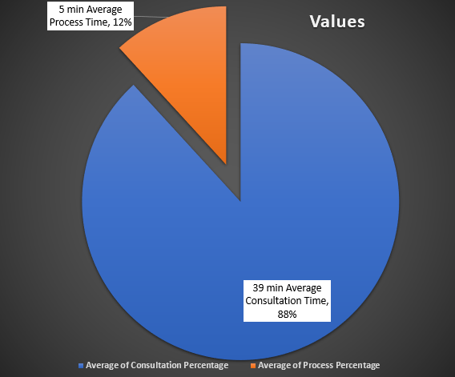
Where do we need more staffing
This Pie Chart shows exactly where the most amount of time gets consumed, during the consultation.
As such clinic should assign more medical staff to reduce the amount of time consultations take, assuming the long consultations is caused by limited amounts of doctors.

Slide 8
Summary
Based on our analysis, the cause of the long waiting times is most experienced during the morning rush and as such clinic should had more doctors/medical staff to help reduce the long consultation periods.
Factors to consider on the clinics side.
It should determine whether it makes financial sense to add more medical staff in the mornings to counterattack the complaints of long wait period by patients.

